Slide 1
.Net Standard 2.0

Slide 2

Why .Net Standard?
There are many Verticals for .Net Platforms with similar base class libraries

Slide 3

Can we build libraries for common Platform?
Answer: .Net Standard !!!

Slide 4
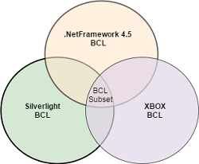
Portable Class libraries
It is a reusable library project where we specify the .Net Platforms we are planning to target during creation of library.
Advantage: allowed code sharing between multiple platforms.
DisAdvantage: adding a new platform support requires re-compiling against the new set of target platforms and removing the API references that are not part of new intersection of base class libraries and does not have any control on the target platforms which were still evolving separately.

Slide 5
What is .Net Standard?
It is a subset of all Base Class Libraries of different .Net Platforms (e.g. full .NetFramework, .Net Core, Xamarin, Silverlight, XBox etc)

Slide 6
Is it a Framework or not?
.Net Standard is not a framework or platform of its own. It does not have implementations or a runtime, just defines a specification what different .Net platforms has to implement to remain .Net Standard complaint.
Eg.. .Net Core is a framework with runtime that implements .NetStandard.

Slide 7
Broad Platform Support.
.NET Framework 4.6.1
.NET Core 2.0
Mono 5.4
Xamarin.iOS 10.14
Xamarin.Mac 3.8
Xamarin.Android 7.5
UWP is work in progress and will ship later this year.

Slide 8
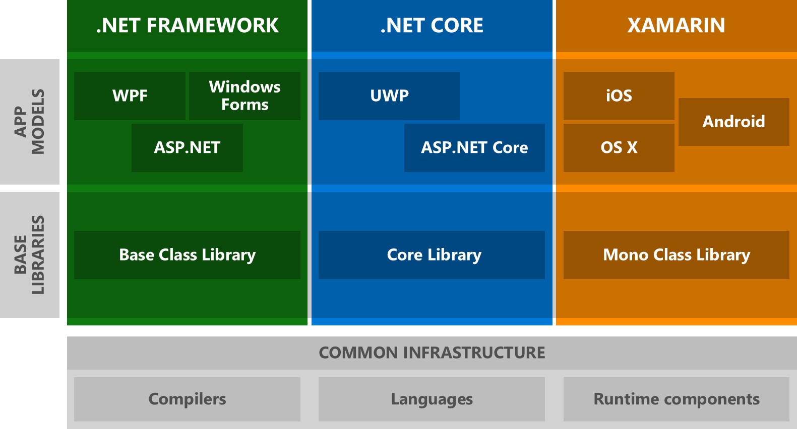
Architecture Diagram with Base Class Library

Slide 9
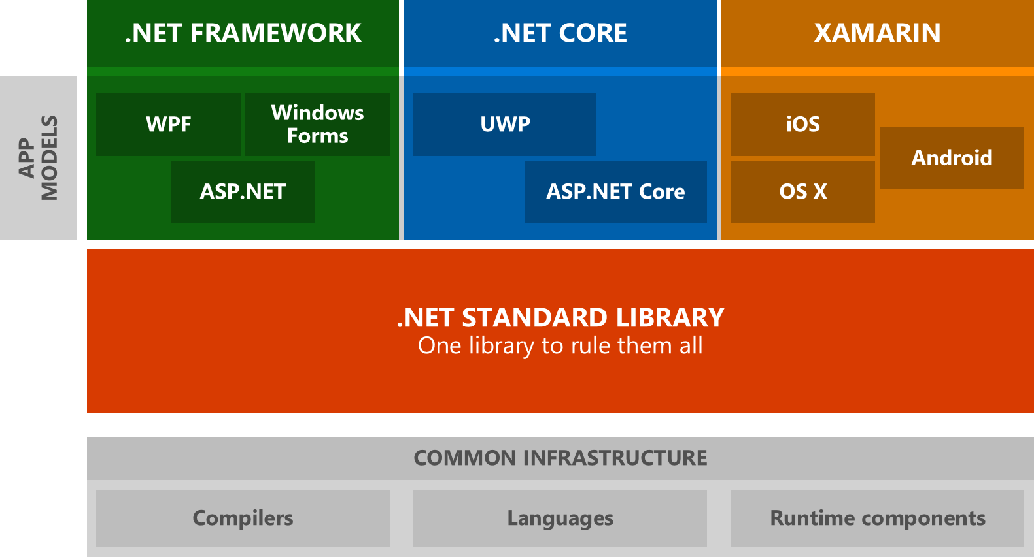
Architecture Diagram with .NetStandard.dll

Slide 10
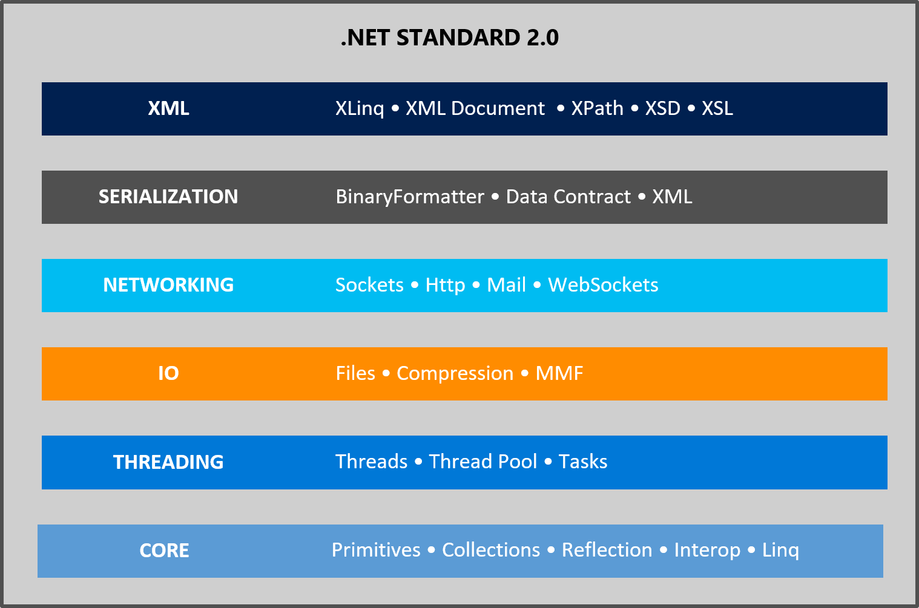
.Net Standard Architecture

Slide 11
How is .NET Standard different from .NET Core?
.NET Standard is a specification that covers which APIs a .NET platform has to implement.
.NET Core is a concrete .NET platform and implements the .NET Standard.

Slide 12
Which .NET Standard version should you target?
The higher the version, the more APIs are available to you.
The lower the version, the more platforms implement it.
13k in .NET Standard 1.6 to 32k in .NET Standard 2.0.
To develop a library that supports .NetFramework 4.5.1 and .Net Core 1.0, we need to target .Net Standard 1.2 i.e. the lowest .NetStandard version that the 2 frameworks implement.

Slide 13
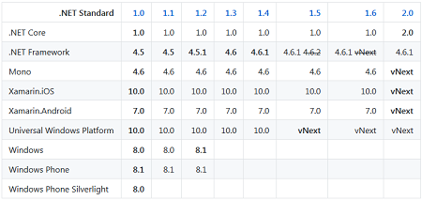
.Net Standard Versions and Platform Support

Slide 14
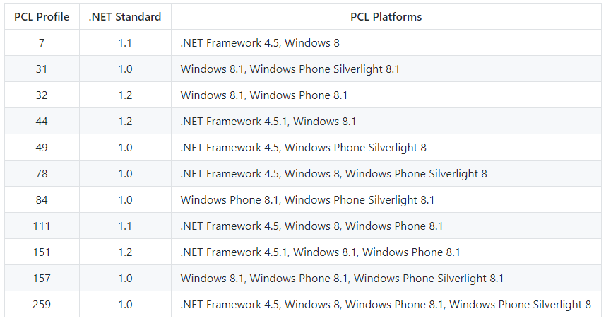
Mapping PCL Profiles to .NET Standard

Slide 15
.Net Standard Version and Platform Supports
A library targets a specific framework. .NET Standard is a synthetic framework, which represents a standardized set of APIs across all .NET platforms. A library can also target a specific .NET platform, in which case it gets access to platform-specific APIs. For example, when targeting Xamarin.iOS you also get access to iOS APIs.
A .NET platform implements a specific .NET Standard version.
A .NET platform supports all .NET Standard versions that are equal to or lower than the version it implements. For instance, if a .NET platform implements .NET Standard 1.5, it supports 1.0 - 1.5. If it implements .NET Standard 2.0, it supports 1.0 - 2.0

Slide 16
Highlights on .Net Standard APi’s
1. The AppDomain type is part of .NET Standard
The primary reason we expose this type in .NET Standard is because the usage is fairly high and typically not associated with creating new app domains but for interacting with the current app domain, such as registering an unhandled exception handler or asking for the application's base directory.
2. No Remoting dll's are part of .Net Standard but MarshalByRefObject
3. NET Standard will contain the abstractions (DbProvider, DbProviderFactories, DbConnection, IDbConnection etc.) as well as the general ADO.NET facilities (DataSet, DataTable etc.) APIs. Providers are not part of .Net Standard as they remain platform specific.

Slide 17
Highlights on .Net Standard APi’s cont..
4. JSON.NET not part of .NET Standard
5. "Type" for example, methods, properties, etc is not added to .net Standard. It remains platform specific.
6. Unity is not supported currently.
7.Extensions exist outside of the .NET Standard and must be manually referenced.
8..NET Standard you are only getting what is in the BCL, not what we know as the Framework Class Library (FCL). Frameworks in this case are application platforms like ASP.NET (System.Web and OWin based), WinForms, WPF, WCF etc. For .NET Core ASP.NET 5 is an Application Framework that lives ontop of .NET Standard.

Slide 18
Highlights on .Net Standard APi’s continued...
8..NET Standard you are only getting what is in the BCL, not what we know as the Framework Class Library (FCL). Frameworks in this case are application platforms like ASP.NET (System.Web and OWin based), WinForms, WPF, WCF etc. For .NET Core ASP.NET 5 is an Application Framework that lives ontop of .NET Standard.

Slide 19
Inclusive Principles
Ubiqutous APIs. APIs in the .NET Standard must be implemented by all .NET platforms. Thus, we're only interested in standardizing APIs that are universal in nature and thus should be available everywhere.
Mature APIs. APIs that are part of the .NET Standard can only be versioned when the standard itself is versioned. Thus, we generally only standardize APIs that are mature enough that they don't have to be updated frequently.
Runtime-specific APIs. If the APIs have to be implemented by the runtime, they don't benefit from being libraries on top of .NET Standard. Good examples of such APIs include primitive types, reflection, GC, and code-gen intrinsics (SIMD).
Widely-used APIs. In order to enable a vibrant .NET ecosystem, it's important to have a common vocabulary of types that library authors can rely on. Thus, it's beneficial to add widely used APIs to the .NET Standard as it simplifies building reusable libraries.
https://github.com/dotnet/standard/blob/master/docs/review-board/README.md#inclusion-principles

Slide 20
.NET Framework 4.6.1 supporting .NET Standard 2.0
.NET Framework 4.6.1 already implements all the APIs that are part of .NET Standard 2.0.
.NET Standard 2.0 adds 14,994 APIs that .NET Framework 4.6.1 already supports and.NET Standard 2.0 only has 43 APIs that .NET Framework 4.6.1 doesn't support

Slide 21
.NET Standard Comparisons
https://github.com/dotnet/standard/blob/master/docs/comparisons/netstandard2.0_vs_net461/README.md
https://github.com/dotnet/standard/tree/master/docs/comparisons
https://github.com/dotnet/standard/blob/master/docs/versions/netstandard1.6.md
https://github.com/dotnet/standard/blob/master/docs/versions/netstandard2.0.md
https://docs.microsoft.com/en-us/dotnet/standard/net-standard

Slide 22
Publish for .Net Standard 2.0
.NetStandard2.0 is for class library projects. It cannot be target for web application.
There is no major changes in published binaries. Only increase in number of dlls in published binaries.

Slide 23
Deployment standpoint for .netframework, .netcore. with and with out .net standard.
There is increase in number of dlls after publishing any .netstandard2.0 library referenced library.
Executable projects (Web or Window or WebApi) will target .net framework 4.x. There is no change in that reference.

Slide 24
.Net Standard with csproj and related to project.json , format differences and how it is resolved.
With project.json:
"frameworks": {
"netcoreapp1.1": {
"dependencies": { },
"imports": [ "netstandard2.0", "Portable-net45+win10" ] } }

Slide 25
Format differences between csproj and project.json and how it is resolved.
With csproj:
<Project Sdk="Microsoft.NET.Sdk">
<PropertyGroup>
<TargetFramework>netstandard2.0</TargetFramework>
</PropertyGroup>
</Project>

Slide 26

Which Framework is target which presentation layer(WinForms, WebForms, Console....etc).
In Visual Studio 2015 .net core is executable project type and targeting netstandard for an executable project type is not supported.
WinForms: we can reference ClassLibrary (Portable) with target as .netstandard1.4 which targets Framework4.6.2
Console: we can reference ClassLibrary (Portable) with target as .netstandard1.4 which targets Framework4.6.2
WPF: we can reference ClassLibrary (Portable) with target as .netstandard1.4 which targets Framework4.6.2

Slide 27
Memory utilization and performance
.NET Core includes the .NET runtime, a set of framework libraries, a set of software development kit tools and language compilers. .NET Standard is an API spec that describes the .NET interfaces that developers can use across all .NET platforms.
NET Core 2.0 provides performance improvements in the runtime and framework. It adds support for .NET to six new platforms, including Debian Stretch, SUSE Linux Enterprise Server 12 SP2 and macOS High Sierra.

Slide 28
TPL library for .net Standard
Threadpool would be a nomination in .NET 2.0 which is kind of similar with TP. Provides a pool of threads that can be used to execute tasks, post work items, process asynchronous I/O, wait on behalf of other threads, and process timers.
TPL actually uses Threadpool under the hood. TPL handles the partitioning of the work, the scheduling of threads on the ThreadPool, cancellation support, state management, and other low-level details.
BackgroundWorker class which has been available from .NET Framework 2.0+

Slide 29
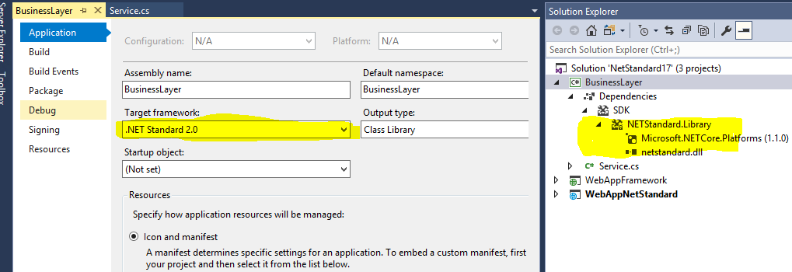
.Net Core in VS2017

Slide 30
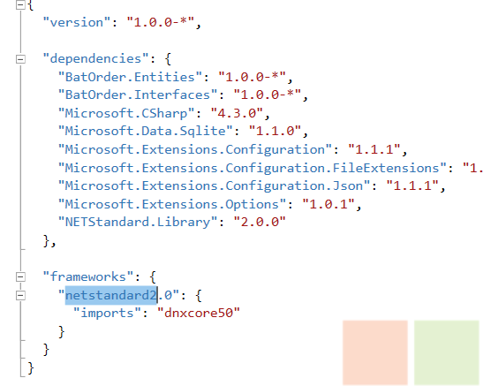
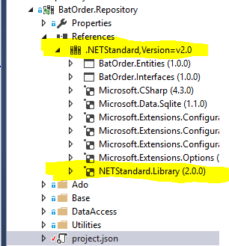
.Net Core in VS2015 with .Net Standard 2.0

Slide 31
View Useful links
http://www.c-sharpcorner.com/article/what-is-net-standard/
http://www.codedigest.com/quick-start/9/what-is-netstandard
https://github.com/dotnet/standard/blob/master/docs/versions/netstandard2.0.md
https://elanderson.net/2016/10/create-a-net-standard-library-for-use-with-full-net-framework/
https://github.com/dotnet/corefx/issues/18217
https://github.com/dotnet/standard/blob/master/netstandard/src/ApiCompatBaseline.net461.txt

